Slide 1


Intelligent Energy Re-routing in Solar Homes using ML
Name Reg. No
1 G. Sai Vishwak 21K91A6747
2 A. Sai Madhan 21K91A6704
3 B. Harini 21K91A6723
4 A. Manikanta 21K91A6706
Reddy
Guide Name
Mr. K. Sreenivas Reddy
CSE (DATA SCIENCE)

Slide 2
Outline Of Presentation
Introduction
Abstract
Existing System
Limitations Of Existing System
Proposed System
Methodologies
Algorithms
Technologies
Literature Surveys
Survey Conclusion
Problem Statement
Screenshots
Conclusion
CSE (DATA SCIENCE)

Slide 3
Introduction
The project aims to develop an intelligent energy management system that optimizes the energy usage in smart homes equipped with photovoltaic solar panels and battery storage.
Inspired by the increasing demand for sustainable energy management in residential areas, the system minimizes the reliance on grid electricity while maximizing the use of renewable energy.
By leveraging advanced Machine Learning techniques, The system predicts energy production and demand, enabling real-time adjustments to optimize energy distribution and usage.
Future enhancements include improved battery management strategies and integration with various smart home configurations to increase flexibility and efficiency.
The ultimate goal is to develop a reliable system that improves energy efficiency, reduces carbon footprint, and enhances the resilience of smart homes against energy fluctuations and outages.
CSE (DATA SCIENCE)

Slide 4
Abstract
The “Intelligent energy re-routing in smart solar homes using ML” initiative focuses on developing an intelligent energy management system for smart homes equipped with photovoltaic solar panels and battery storage. The goal is to minimize reliance on grid electricity by optimizing the use of solar-generated energy and efficiently utilizing stored energy during periods of low solar availability. The system continuously monitors and forecasts weather conditions to assess solar energy production potential and predicts household energy demand based on factors such as time of day and weather-related impacts. It dynamically decides the optimal energy source—whether from solar panels, battery storage, or the grid—based on real-time data, ensuring maximum efficiency and sustainability. Additionally, the system incorporates strategic battery management to charge during periods of excess solar energy, enhancing the resilience and energy efficiency of the home. This project represents a significant step towards achieving energy-efficient, self-sufficient smart homes with reduced carbon footprints.
CSE (DATA SCIENCE)

Slide 5
Existing System
Traditional energy management systems in smart homes often lack efficiency in managing the variability of solar energy generation and household energy demands.
Existing solutions primarily use static energy allocation methods, leading to suboptimal utilization and increased dependence on grid electricity.
Failing to leverage advanced weather forecasting and demand prediction models, limiting their ability to adapt dynamically.
The absence of intelligent integration of PV panels, battery storage, and grid power results in inefficient energy routing.
There is a growing need for a system that delivers real-time insights, supports sustainable practices, and ensures scalability for diverse households.
Key points: Static energy allocation, Suboptimal utilization, Weather forecasting, Demand-prediction models, Real-time insights, Grid power, Battery storage, Variability, Scalability
CSE (DATA SCIENCE)

Slide 6
Limitations Of Existing System
Existing energy management systems for smart solar homes face several limitations:
Static Energy Allocation: Many systems employ predefined energy routing strategies that do not adapt to real-time changes in energy generation and demand.
Lack of Predictive Models: Current solutions do not utilize advanced weather forecasting or energy demand prediction models, limiting their ability to optimize energy usage.
Inefficient Battery Management: Battery charging and discharging strategies in most systems are inefficient, leading to energy wastage and reduced battery lifespan.
Over-reliance on Grid Electricity: Poor energy utilization often results in unnecessary dependence on grid power, increasing costs and reducing system efficiency.
Limited Scalability: Existing systems are often tailored to specific use cases, lacking the flexibility to adapt to varying household energy needs and configurations.
CSE (DATA SCIENCE)

Slide 7
Proposed System
Dynamic Energy Routing: The system analyses real-time data on solar energy generation, battery status, and energy demand to allocate energy seamlessly between PV panels, battery storage, and the grid.
Weather and Demand Prediction: Advanced machine learning models predict solar energy availability and household energy demands, enabling proactive energy allocation.
Strategic Battery Management: Batteries are efficiently charged during periods of surplus solar energy and discharged during low solar availability to minimize grid dependency.
Real-time Monitoring and Insights: Users can access detailed energy production, consumption, and storage data through an intuitive dashboard.
Scalability and Flexibility: The system is adaptable to diverse household configurations, supporting integration with IoT devices and smart home automation setups.
CSE (DATA SCIENCE)

Slide 8
Methodologies
Data Collection:
Gathering historical weather data and energy usage records.
Acquiring real-time data from solar panels and battery systems.
Weather Data Analysis:
Forecasting weather conditions to estimate solar energy production.
Analyzing patterns and trends to improve prediction accuracy.
Energy Demand Prediction:
Predicting household energy requirements based on historical usage and weather conditions.
Real-time Decision-Making:
Implementing algorithms to dynamically decide the optimal energy source based on real-time data.
CSE (DATA SCIENCE)

Slide 9
Algorithms
Time Series Forecasting:
Used for predicting future weather conditions and solar energy production based on historical data.
Regression Analysis:
Applied to predict household energy demand by analyzing relationships between various factors such as weather conditions and historical usage patterns.
Decision Trees for Energy Management:
Utilized for making real-time decisions on energy sourcing by evaluating different criteria such as solar production, battery status, and energy demand.
Optimization Algorithms for Battery Charging/Discharging:
Employed to determine the optimal battery management strategy, ensuring efficient use of stored energy and prolonging battery life.
CSE (DATA SCIENCE)

Slide 10
Technologies
Front-End Technologies:
HTML5/CSS3: Used for structuring the document and styling the user interface.
JavaScript: Provides interactivity and handles dynamic updates on the web application.
Chart.js: A JavaScript library for building responsive and interactive charts, enabling real-time monitoring and control of energy management.
Bootstrap: A CSS framework for creating a responsive and mobile-first front-end design.
CSE (DATA SCIENCE)

Slide 11
Technologies
Back-End Technologies:
Python: The core programming language for data processing, developing machine learning models, and backend logic.
Flask: Web frameworks for building robust, scalable server-side applications that manage communication between the front-end and the machine learning models.
RESTful APIs: For enabling communication between the front-end interface and the back-end services, ensuring smooth data flow and real-time updates.
SQL Databases: For storing and managing historical weather data, energy consumption records, and model predictions e.g., PostgreSQL.
Cloud Computing Services: For scalable data storage, processing, and deploying machine learning models e.g., AWS, Google Cloud.
CSE (DATA SCIENCE)

Slide 12
List Of Survey Papers
A Hybrid Approach for Home Energy Management With Imitation Learning and Online Optimization
Authors: Shuhua Gao; Raiyan bin Zulkifli Lee; Zhenhao Huang; Cheng Xiang; Ming Yu;
https://ieeexplore.ieee.org/document/10304403
A Multistage Home Energy Management System With Residential Photovoltaic Penetration
Authors : Fengji Luo; Gianluca Ranzi; Can Wan; Zhao Xu; Zhao Yang Dong(20 September 2018)
https://ieeexplore.ieee.org/document/8469052
A Novel Single-Stage Single-Phase Reconfigurable Inverter Topology for a Solar Powered Hybrid AC/DC Home
Author : Nikhil Sasidharan; Jai Govind Singh 22 December 2016
https://ieeexplore.ieee.org/document/7795211
A Shrinking Horizon Model Predictive Controller for Daily Scheduling of Home Energy Management Systems
Author : Ali Esmaeel Nezhad; Abolfazl Rahimnejad; Pedro H. J. Nardelli; Stephen Andrew Gadsden; Subham Sahoo;(10 March 2022)
https://ieeexplore.ieee.org/document/9732346
CSE (DATA SCIENCE)

Slide 13
List Of Survey Papers
An Intelligent Home Energy Management System to Improve Demand Response
Authors : Yusuf Ozturk; Datchanamoorthy Senthilkumar; Sunil Kumar; Gordon Lee 15 April 2013
https://ieeexplore.ieee.org/document/6502291
Deep Reinforcement Learning for Real-Time Energy Management in Smart Home
Authors : Guixi Wei; Ming Chi; Zhi-Wei Liu; Mingfeng Ge; Chaojie Li; Xianggang Liu 10 March 2023
https://ieeexplore.ieee.org/document/10066193
Peak Reduction and Long Term Load Forecasting for Large Residential Communities Including Smart Homes With Energy Storage
Authors : Liang Yu; Weiwei Xie; Di Xie; Yulong Zou; Dengyin Zhang; Zhixin Sun; Linghua Zhang; Yue Zhang; https://ieeexplore.ieee.org/document/8919976
Optimization of stand alone Solar Home System with battery
Authors : Isdawimah; Nuha Nadhiroh; A. Damar Aji 27 December 2021
https://ieeexplore.ieee.org/document/9649406
CSE (DATA SCIENCE)

Slide 14
List Of Survey Papers
Optimization-based home energy management in the presence of solar energy and storage
Authors : Sattar Mohammadi; Mahmoud Momtazpour; Esmaeil Sanaei
https://ieeexplore.ieee.org/document/6599649
https://ieeexplore.ieee.org/document/9070340
Authors : Anusha Manur; Maitreyee Marathe; Ashray Manur; Abhishek Ramachandra; Shamsundar Subbarao; Giri Venkataramanan
https://ieeexplore.ieee.org/document/9070340
Federated Reinforcement Learning for Energy Management of Multiple Smart Homes With Distributed Energy Resources
Authors: Sangyoon Lee; Dae-Hyun Choi
https://ieeexplore.ieee.org/document/9247266
Real-Time Energy Management for Smart Homes
Authors: Subho Paul; Narayana Prasad Padhy
https://ieeexplore.ieee.org/document/9180278
CSE (DATA SCIENCE)

Slide 15
LITERATURE SURVEYS
CSE (DATA SCIENCE)

Slide 16
Literature Survey - 01
Title : A Hybrid Approach for Home Energy Management With Imitation Learning and Online Optimization
Authors : Shuhua Gao; Raiyan bin Zulkifli Lee; Zhenhao Huang; Cheng Xiang; Ming Yu
Description :
This study introduces a hybrid home energy management system using imitation learning (IL) and online optimization for solar-equipped households. Deep neural networks (DNNs) control shiftable loads, while mixed-integer linear programming (MILP) optimizes adjustable ones. IL reduces training time and enhances energy utilization, outperforming traditional methods in cost efficiency and grid dependency reduction.
Merits :
Successfully integrates IL for faster training compared to RL.
Effective in reducing household electricity costs by leveraging solar energy and dynamic pricing.
Demonstrates scalability across various building sizes with minimal performance loss.
Limitations :
Limited consideration of user-specific comfort requirements.
Complexity increases with additional appliances and larger energy demands.
Relies on accurate real-time data for optimal performance, which may require substantial investment in sensors and data collection.
CSE (DATA SCIENCE)

Slide 17
Literature Survey - 02
Title : A Multistage Home Energy Management System With Residential Photovoltaic Penetration
Authors : Fengji Luo; Gianluca Ranzi; Can Wan; Zhao Xu; Zhao Yang Dong.
Description :
This paper presents a multistage Home Energy Management System (HEMS) for optimizing residential energy use in high rooftop photovoltaic (PV) settings. It integrates forecasting, day-ahead scheduling, and real-time adjustments, with an adaptive thermal model to manage HVAC systems efficiently.
Merits :
Introduces a structured three-stage HEMS for improved scheduling and operational efficiency.
Employs an Artificial Neural Network (ANN) for accurate short-term PV and load forecasting.
Incorporates an adaptive thermal model to enhance HVAC system scheduling.
Limitations :
Limited consideration of non-thermal household appliances.
Relies heavily on forecasting accuracy, leading to potential performance issues with inaccurate data.
Computational complexity in real-time model adjustments.
CSE (DATA SCIENCE)

Slide 18
Literature Survey - 03
Title : A Novel Single-Stage Single-Phase Reconfigurable Inverter Topology for a Solar Powered Hybrid AC/DC Home
Authors : Nikhil Sasidharan; Jai Govind Singh.
Description :
This paper presents a reconfigurable, single-stage inverter for hybrid AC/DC solar homes. It supports DC/DC, DC/AC, and grid-tie operation in one converter, reducing power loss, cost, and size while enhancing power quality. Simulations and hardware tests confirm its potential for smart grid applications.
Merits :
Provides a flexible, single-stage conversion to reduce conversion losses.
Supports hybrid AC/DC loads, improving efficiency in energy distribution within homes.
Reduces harmonic distortion by isolating DC loads to DC supply, enhancing power quality.
Limitations :
Requires specific hardware configurations (e.g., inductor-based design) for optimal performance.
Sensitive to variations in solar radiation, necessitating careful control logic adjustments.
Limited focus on scalability for larger grid-tied systems.
CSE (DATA SCIENCE)

Slide 19
Literature Survey - 04
Title : A Shrinking Horizon Model Predictive Controller for Daily Scheduling of Home Energy Management Systems
Authors : Ali Esmaeel Nezhad; Abolfazl Rahimnejad; Pedro H. J. Nardelli; Stephen Andrew Gadsden; Subham Sahoo; Farideh Ghanavati.
Description :
This study proposes a Shrinking Horizon Model Predictive Controller (SH-MPC) for efficient daily scheduling of residential energy use, integrating photovoltaic (PV) panels and battery storage. The approach minimizes electricity costs by optimizing appliance scheduling based on meteorological and market data.
Merits :
Reduces electricity costs for homeowners with PV and battery storage.
Provides flexibility through real-time energy management.
Evaluates both Time-of-Use (TOU) and Real-Time Pricing (RTP) tariffs.
Limitations :
Computationally intensive due to Mixed-Integer Linear Programming (MILP).
High dependence on accurate meteorological and price data.
Primarily applicable to residential settings.
CSE (DATA SCIENCE)

Slide 20
Literature Survey - 05
Title : An Intelligent Home Energy Management System to Improve Demand Response
Authors : Yusuf Ozturk; Datchanamoorthy Senthilkumar; Sunil Kumar; Gordon Lee.
Description :
This paper introduces an integrated solution for Demand Response (DR) and Time-of-Use (TOU) pricing to optimize residential electricity demand. It features a decision-support system that forecasts energy consumption and dynamically schedules appliance usage while considering user constraints, enhancing participation in DR through smart appliance control.
Merits :
Comprehensive forecasting of electricity demand based on user lifestyle.
Dynamic appliance scheduling improves energy efficiency and user comfort.
Promotes continuous interaction between customers and utility companies for effective DR.
Limitations :
Primarily applicable to residential settings, limiting broader implementation.
Requires user engagement for optimal scheduling preferences.
Accuracy of demand predictions can be affected by unexpected user behavior.
Integration with existing systems may present communication challenges.
CSE (DATA SCIENCE)

Slide 21
Literature Survey - 06
Title : Deep Reinforcement Learning for Real-Time Energy Management in Smart Home
Authors : Guixi Wei; Ming Chi; Zhi-Wei Liu; Mingfeng Ge; Chaojie Li; Xianggang Liu.
Description :
This paper proposes a real-time energy management algorithm using deep reinforcement learning (DRL) with proximal policy optimization (PPO) to optimize appliance scheduling in smart homes. By managing rooftop photovoltaics, energy storage systems, and smart appliances, it aims to minimize energy costs while maintaining user comfort.
Merits :
Incorporates both discrete and continuous action control for diverse appliance types.
Uses PPO, which enhances training efficiency and robustness.
Adapts to real-time changes in temperature, electricity price, and solar irradiation.
Limitations :
Limited to real-time management, potentially complex for large-scale deployments.
Requires extensive historical data for effective training.
Model accuracy may decline with unpredictable user behavior and environmental changes.
CSE (DATA SCIENCE)

Slide 22
Literature Survey - 07
Title : Deep Reinforcement Learning for Smart Home Energy Management
Authors : Liang Yu; Weiwei Xie; Di Xie; Yulong Zou; Dengyin Zhang; Zhixin Sun.
Description :
This paper tackles the challenge of minimizing energy costs in smart homes without relying on a thermal dynamics model. Using a deep deterministic policy gradient (DDPG) approach, the authors design an algorithm to efficiently manage HVAC and energy storage systems (ESS) to reduce costs while maintaining comfort. The algorithm operates on real-time observations, eliminating the need for prior parameter knowledge.
Merits :
Provides a robust solution that adapts to uncertainties in parameters like renewable energy output.
Demonstrates significant energy savings (8.10%–15.21%) compared to baselines, without compromising thermal comfort.
Showcases the algorithm’s resilience and effectiveness in real-world scenarios with variable data inputs.
Limitations :
Does not integrate a comprehensive thermal dynamics model, which may limit adaptability in more complex environments.
The reliance on DDPG may impose higher computational demands, affecting efficiency.
Potential scalability issues for larger residential or multi-unit buildings with more diverse energy requirements.
CSE (DATA SCIENCE)

Slide 23
Literature Survey - 08
Title : Optimization of Stand Alone Solar Home System with Battery
Authors : Isdawimah; Nuha Nadhiroh; A. Damar Aji.
Description :
This paper explores error optimization in designing stand-alone solar home systems with battery storage, focusing on PV module selection, battery sizing, and system losses. A 100 Wp prototype validated the design, using LabVIEW for real-time monitoring with 97.2% accuracy.
Merits :
Comprehensive analysis of solar home system components (PV, battery, cables, protection systems).
Validates design with a real-world prototype and high accuracy (97.2%) in monitoring.
Uses LabVIEW for efficient, real-time parameter monitoring.
Limitations :
Prototype capacity (100 Wp) may limit scalability and applicability for larger systems.
Limited discussion on cost optimization.
Relies on specific environmental data, which may affect accuracy in different conditions.
CSE (DATA SCIENCE)

Slide 24
Literature Survey - 09
Title : Optimization-based home energy management in the presence of solar energy and storage
Authors : Sattar Mohammadi; Mahmoud Momtazpour; Esmaeil Sanaei.
Description :
This paper presents a real-time energy management system for optimizing appliance scheduling and energy storage in smart homes, using solar and grid electricity to minimize household costs. The system leverages an ILP-based Home Energy Management (ILPHEM) optimization engine to handle dynamic electricity prices, scheduling appliances, and managing storage in real time.
Merits :
Reduces household energy costs by 20% compared to conventional approaches.
Efficiently integrates solar energy with grid electricity to optimize energy use.
Provides real-time management and decision-making for cost savings.
Limitations :
Requires precise, real-time data for effective optimization.
Dependent on adequate solar and storage infrastructure.
Complexity may limit scalability in certain environments.
CSE (DATA SCIENCE)

Slide 25
Literature Survey - 10
Title : Smart Solar Home System with Solar Forecasting
Authors : Anusha Manur; Maitreyee Marathe; Ashray Manur; Abhishek Ramachandra; Shamsundar Subbarao; Giri Venkataramanan.
Description :
This study addresses the challenges of solar energy utilization in Solar Home Systems (SHSs), which often experience daily and seasonal variations in solar irradiance and load usage. It proposes a smart solar home system incorporating a forecasting methodology that accounts for battery utilization, leading to improved energy efficiency. The study evaluates field data from deployed smart solar home systems using the proposed forecasting technique.
Merits :
Enhances energy optimization in SHSs by incorporating battery utilization into solar forecasting.
Addresses the limitations of conventional forecasting methods applied to larger systems.
Real-world deployment and evaluation provide practical insights into system effectiveness.
Limitations :
Requires accurate weather data and battery usage forecasting.
Limited computing power in SHSs may restrict optimization potential.
Seasonal solar variation can still impact overall effectiveness.
CSE (DATA SCIENCE)

Slide 26
Literature Survey - 11
Title : Federated Reinforcement Learning for Energy Management of Multiple Smart Homes With Distributed Energy Resources
Authors : Sangyoon Lee; Dae-Hyun Choi
Description :
This article presents a federated reinforcement learning (FRL) framework for energy management in multiple smart homes with appliances, solar systems, and energy storage. It includes local home energy management systems (LHEMSs) and a global server (GS) that optimize energy consumption by aggregating local models into a global model, improving convergence speed and reducing energy costs while considering user preferences.
Merits :
Offers a distributed approach that preserves data privacy and reduces communication overhead.
Demonstrates significant improvement in convergence speed and energy consumption management compared to conventional methods.
Validated through simulations across heterogeneous smart home environments, ensuring effective scheduling of appliances.
Limitations :
Potential complexity in implementation due to the need for local model updates.
Performance may vary depending on the diversity of appliances and user preferences across different homes.
CSE (DATA SCIENCE)

Slide 27
Literature Survey - 12
Title : Real-Time Energy Management for Smart Homes
Authors : Subho Paul; Narayana Prasad Padhy.
Description :
This paper develops a multi objective optimization portfolio for real-time energy management in smart homes equipped with battery-associated rooftop solar panels, lighting loads, air conditioners, and other smart appliances. The framework addresses the simultaneous minimization of monetary energy costs and total dissatisfaction due to regulation in power consumption, using a mixed-integer convex nonlinear programming approach.
Merits :
Presents a novel multi objective real-time energy management optimization framework.
Uses current data without needing probabilistic estimation for renewable generation, energy price, and load demand.
Demonstrates superiority over traditional greedy algorithms through practical case studies.
Limitations :
Requires accurate real-time data, which may increase operational complexity.
Results based on specific scenarios may require customization for varied household patterns.
Does not account for historical data, potentially limiting the adaptability of the optimization.
CSE (DATA SCIENCE)

Slide 28
Survey Conclusion
The advancement of intelligent home energy management solutions relies on the integration of innovative computational techniques and dynamic control systems, enabling real-time adaptability and improved energy efficiency for modern households.
The performance of machine learning and optimization models in this domain is often constrained by data quality, emphasizing the critical need for accurate, high-resolution data from diverse sources, including real-time environmental and user-specific inputs, to optimize energy scheduling and usage.
Incorporating renewable resources such as solar energy alongside battery storage systems significantly enhances the sustainability and cost-efficiency of energy management frameworks, enabling households to minimize grid dependency while meeting personalized energy demands.
Open access to standardized datasets and improved data-sharing protocols would facilitate benchmarking, allowing more comprehensive testing and comparison of different energy management approaches across varied residential setups.
Future research should focus on creating user-centric, resilient models that seamlessly integrate with existing smart home technologies, enabling real-time, personalized energy solutions that can adapt to evolving household needs and environmental conditions.
CSE (DATA SCIENCE)

Slide 29
Problem Statements
Efficient Energy Re-routing in Smart Solar Homes: How can energy be intelligently re-routed within a smart solar home to maximize the utilization of available solar power and reduce dependency on the grid?
Optimizing Energy Storage and Consumption: How can real-time energy demand and storage capacity be balanced in smart homes, ensuring energy availability during peak hours while minimizing costs?
Minimizing Energy Loss During Transmission: How can intelligent energy routing systems in smart solar homes reduce energy losses during transmission, ensuring that more solar-generated power is efficiently utilized within the household?
Integration of Solar Forecasting for Energy Efficiency: How can solar energy forecasting be integrated into energy routing systems to enhance predictive energy management in smart homes with variable weather conditions?
CSE (DATA SCIENCE)

Slide 30
Problem Statements
Enhancing Load Flexibility and User Comfort: How can load flexibility be effectively managed in intelligent energy systems to ensure optimal energy distribution without compromising user comfort?
Addressing Data Challenges in Real-Time Energy Optimization: What challenges arise from utilizing real-time data in energy re-routing systems, and how can these challenges be mitigated to improve the efficiency of smart solar homes?
Scalability of Intelligent Energy Re-routing Solutions: How can intelligent energy re-routing systems be scaled to accommodate diverse household sizes and energy demands, making them adaptable for broader residential applications?
CSE (DATA SCIENCE)

Slide 31
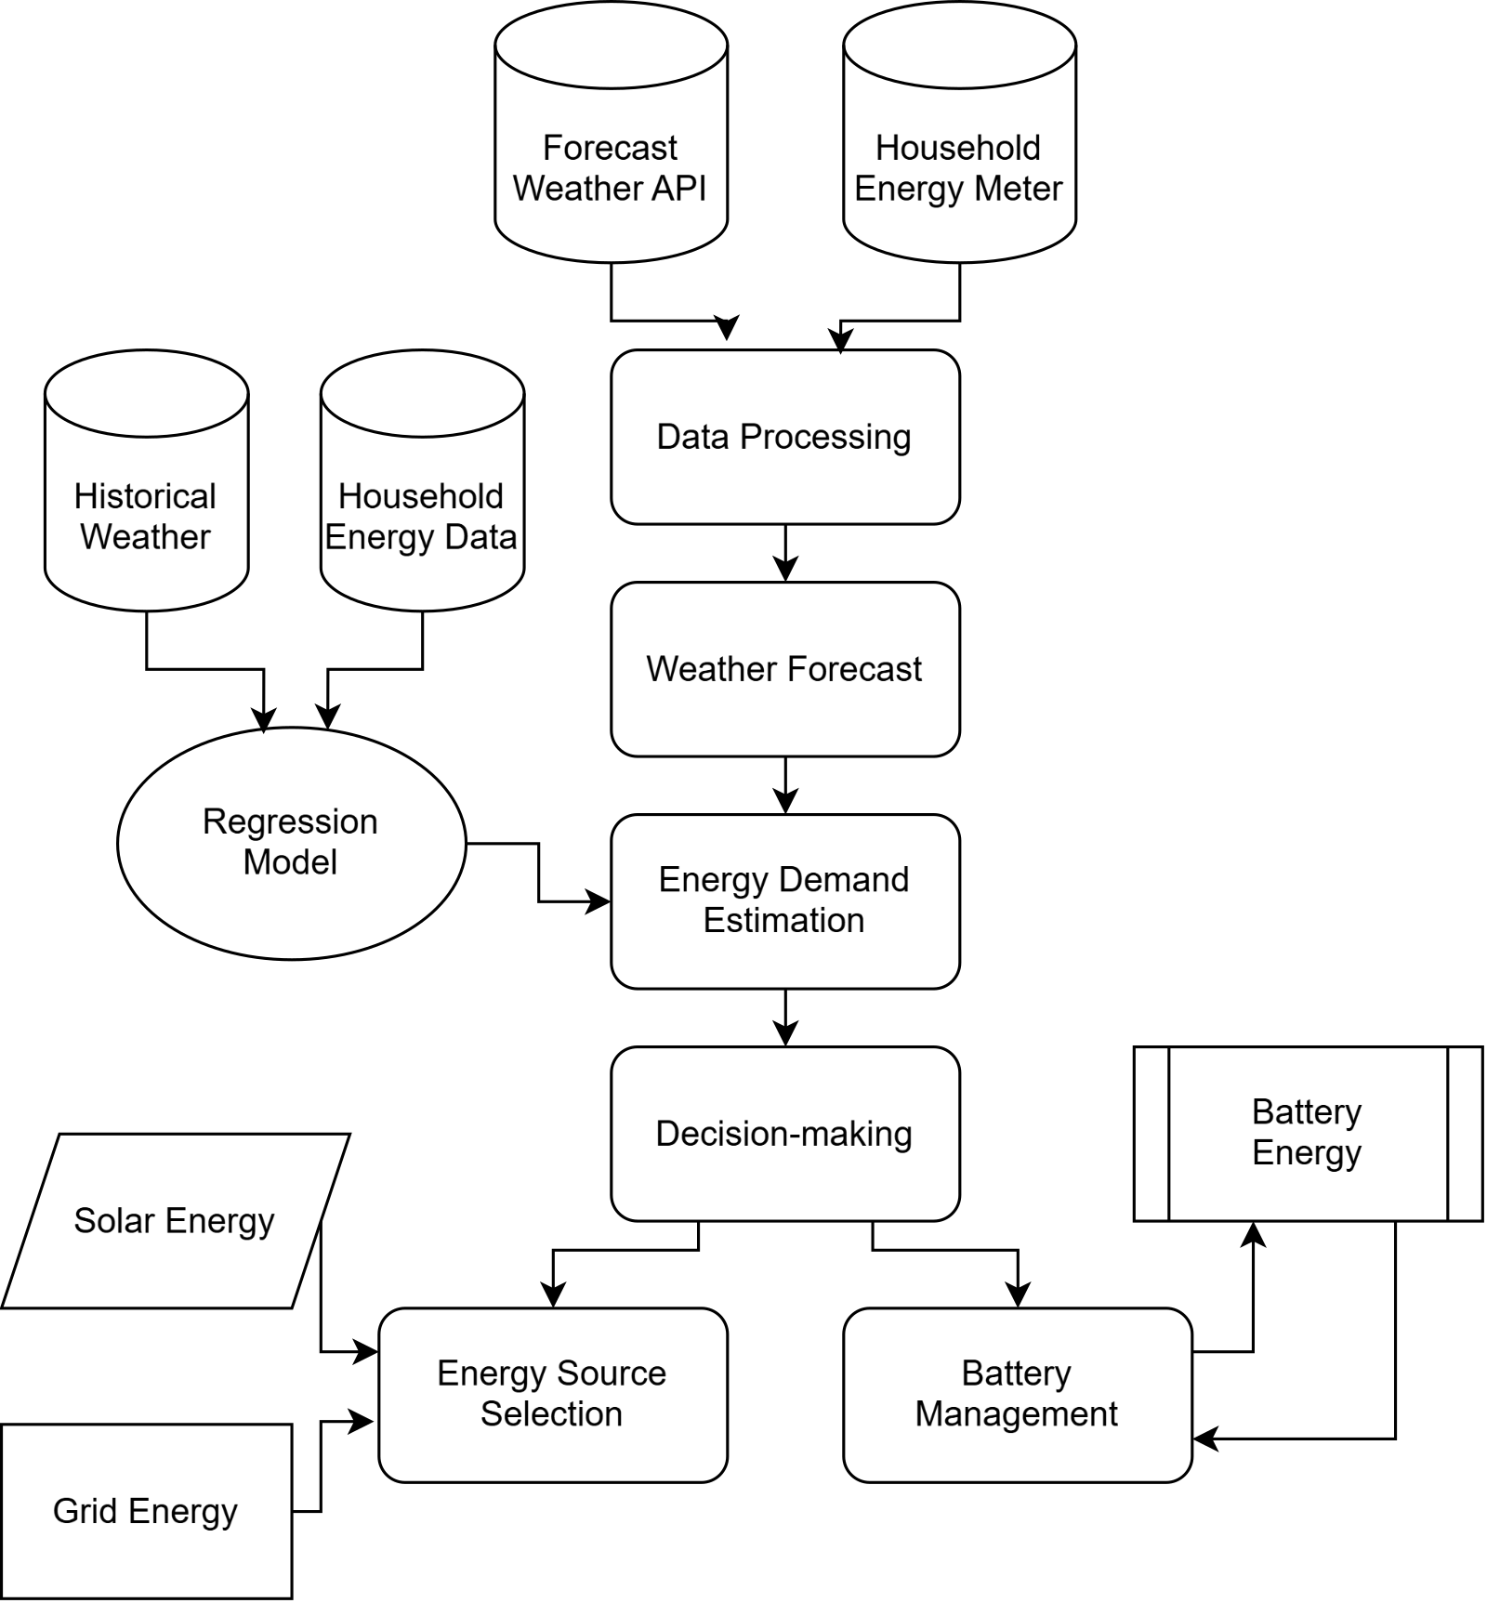
Architecture Diagram
CSE (DATA SCIENCE)

Slide 32
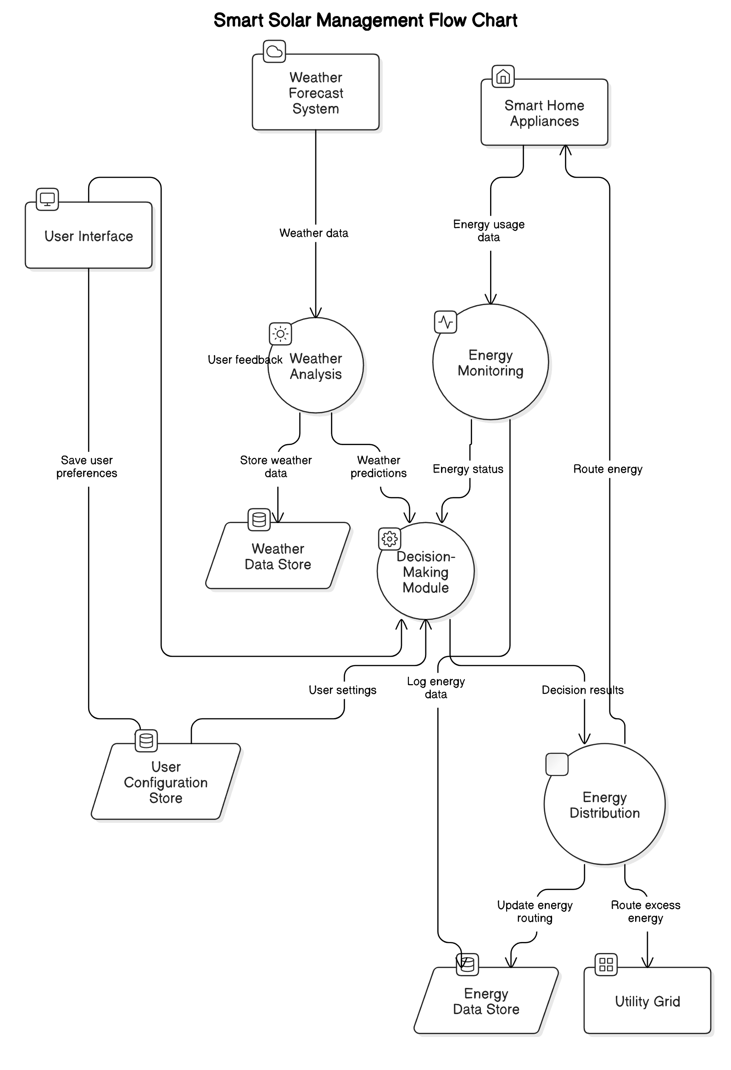
Data-Flow Diagram
CSE (DATA SCIENCE)

Slide 33
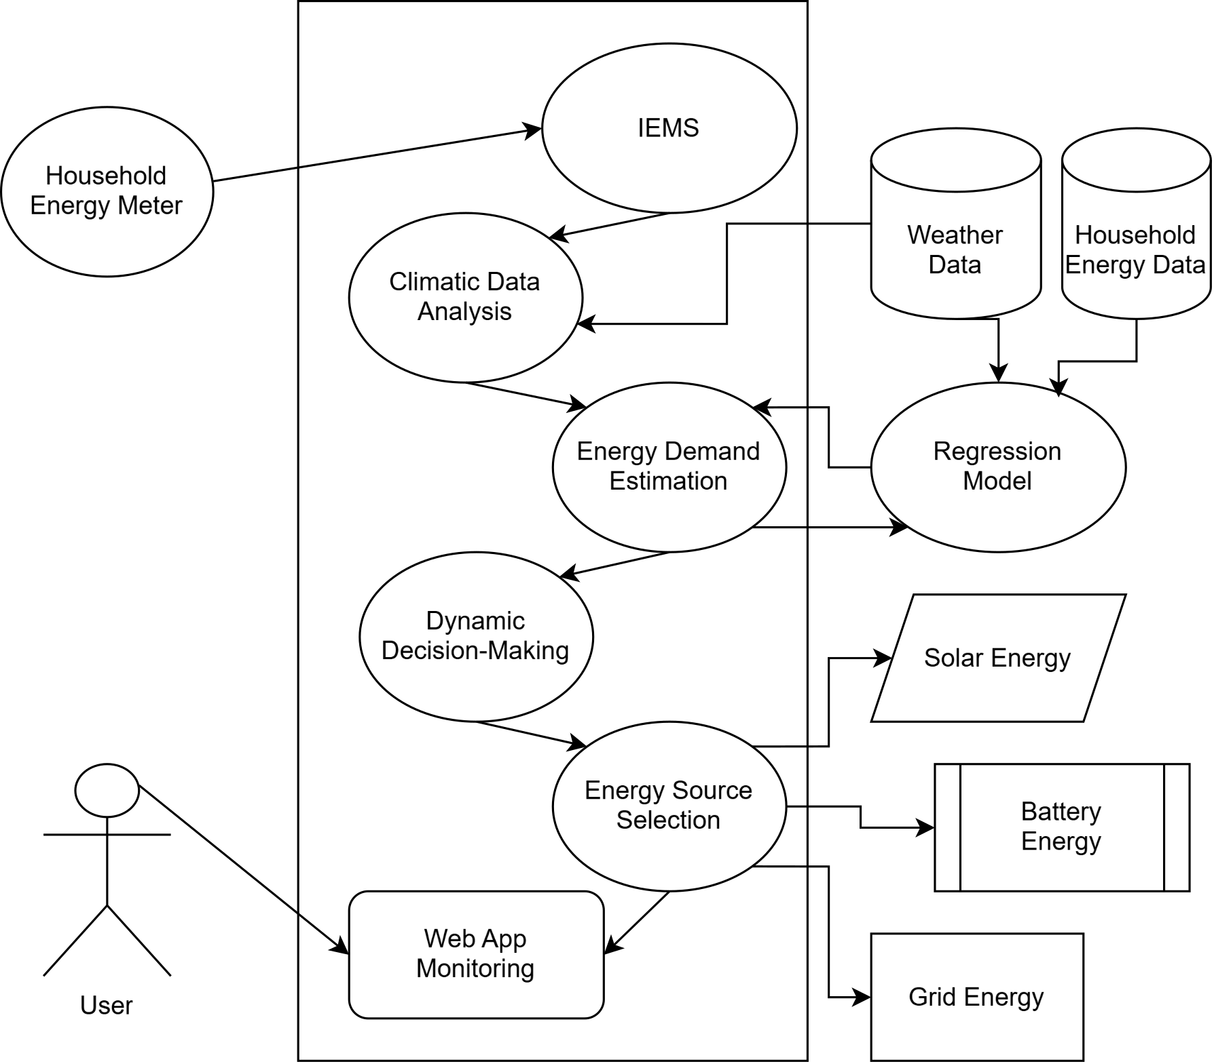
Use Case Diagram
CSE (DATA SCIENCE)

Slide 34
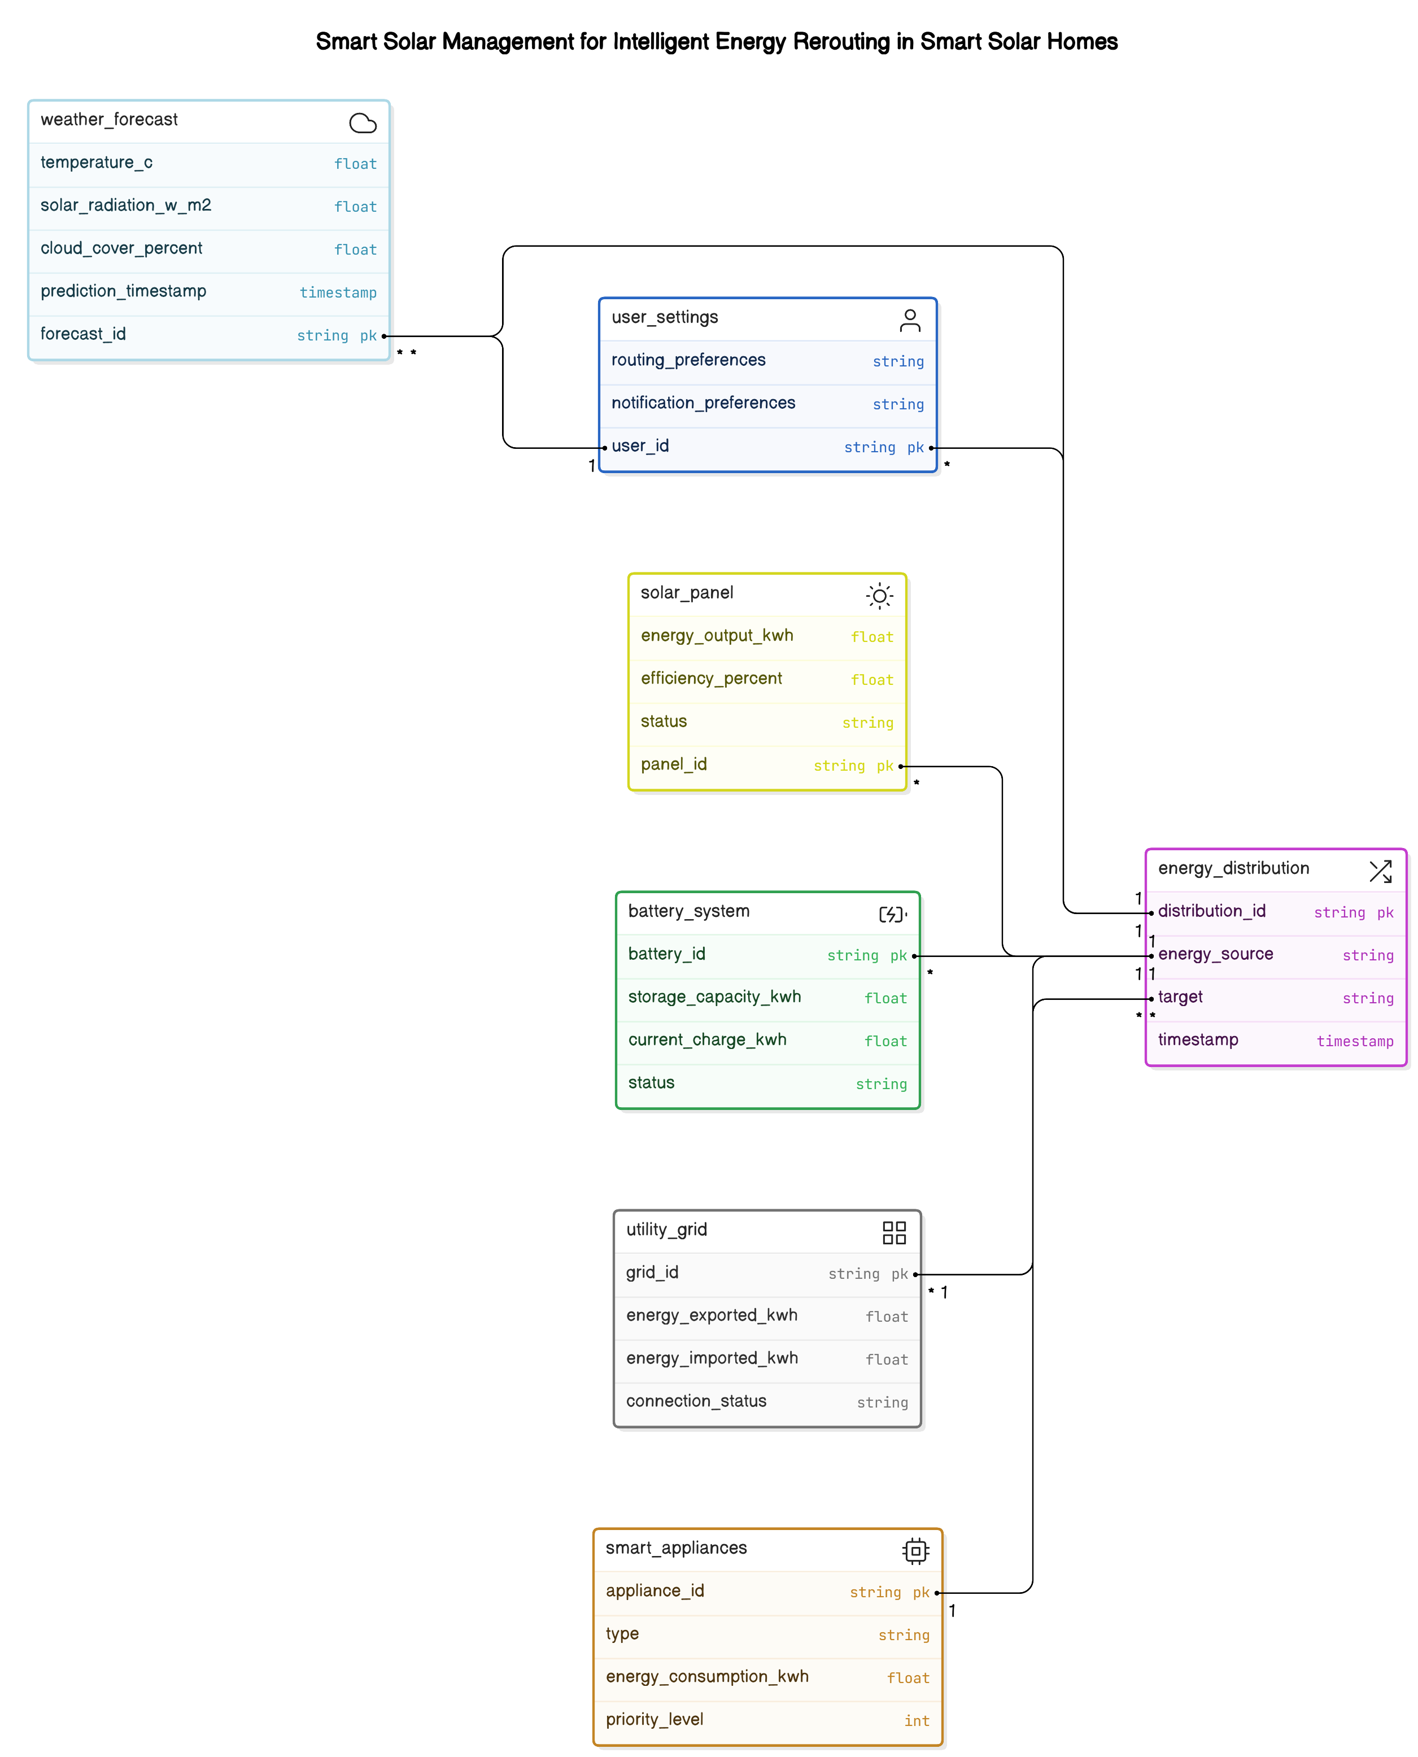
Relationship Diagram
CSE (DATA SCIENCE)

Slide 35
Modules
HOME PAGE
DASHBOARD
REPORT
Daily Report
Weekly Report
Monthly Report
Yearly Report
FORECAST
Temperature Forecast
Irradiance Forecast
STATUS
Solar Panel Status
Battery Status
CSE (DATA SCIENCE)

Slide 36

Screenshots
Home Page
CSE (DATA SCIENCE)

Slide 37
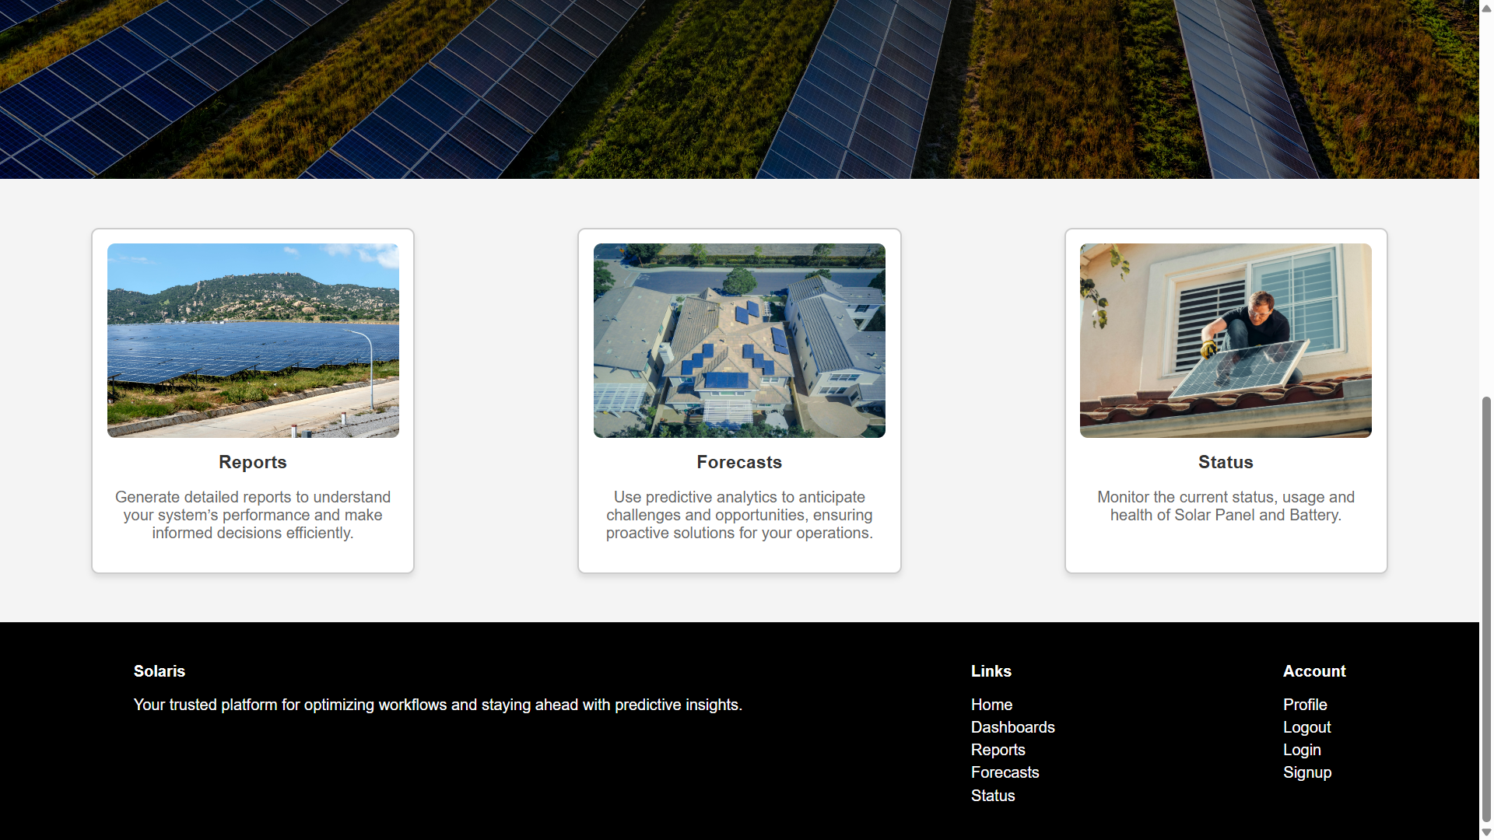
Screenshots
Home Page
CSE (DATA SCIENCE)

Slide 38
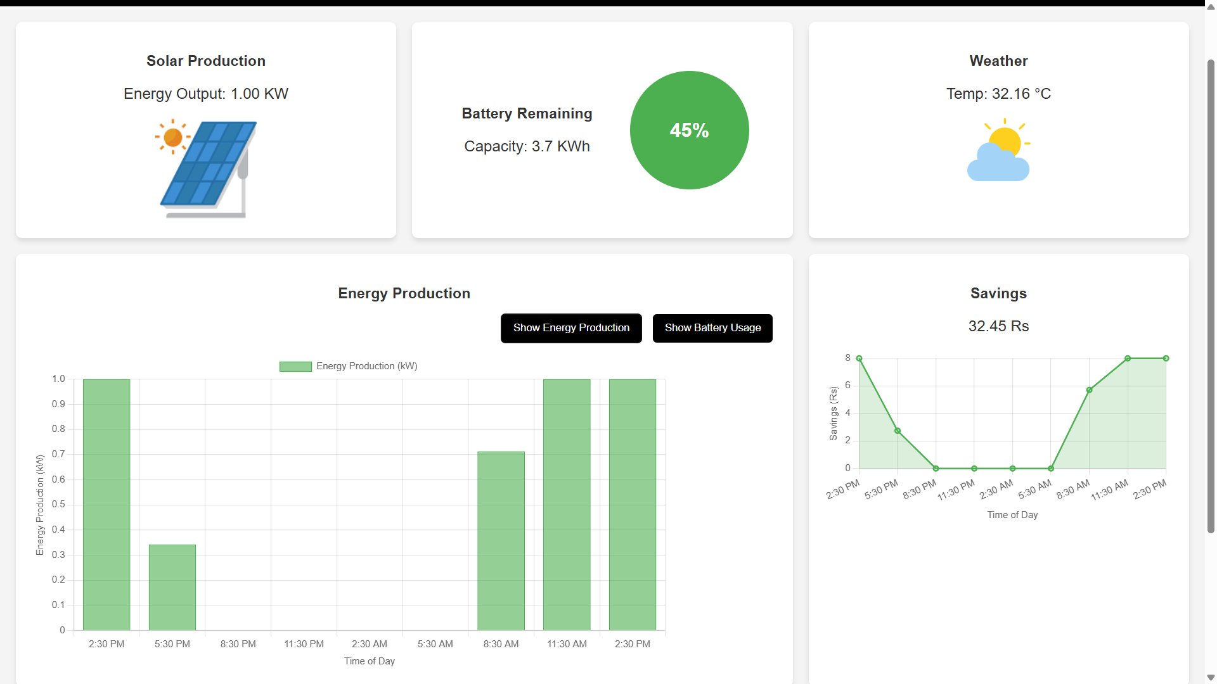
Screenshots
Dashboard – Energy Production Module
CSE (DATA SCIENCE)

Slide 39
Screenshots
Dashboard – Battery Usage Module
CSE (DATA SCIENCE)

Slide 40
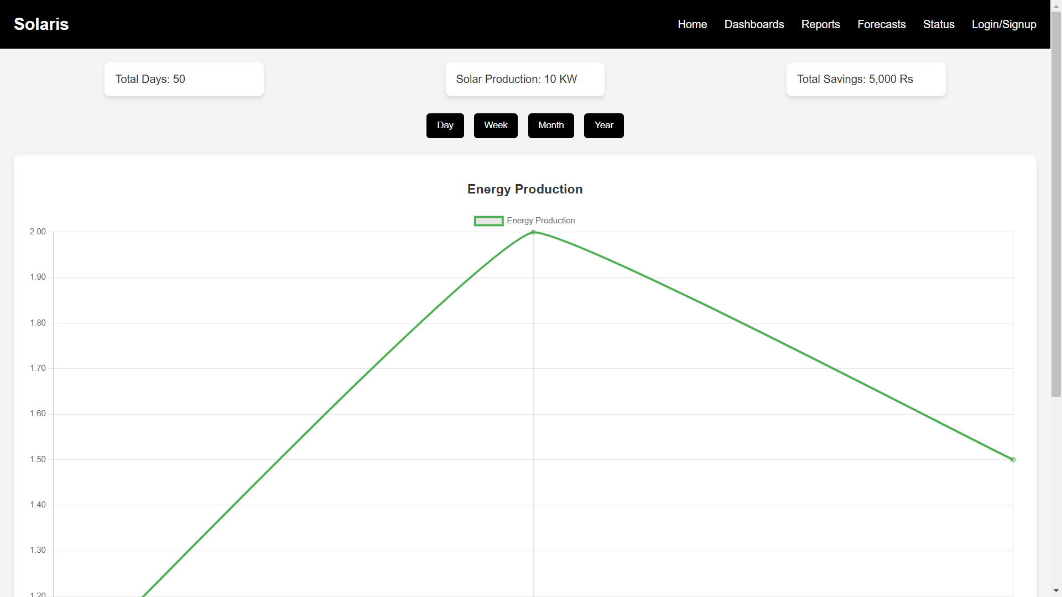
Screenshots
Report Module
CSE (DATA SCIENCE)

Slide 41
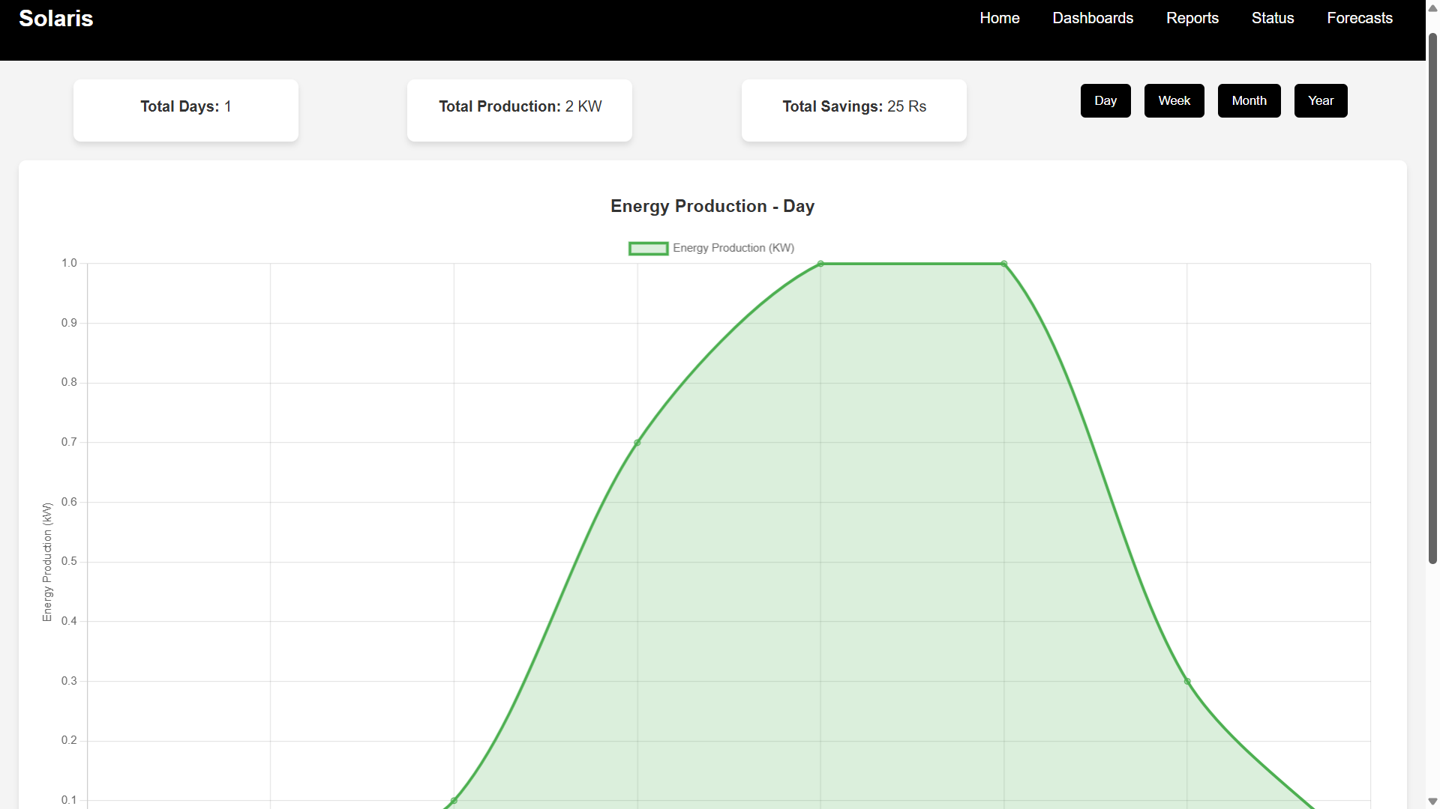
Screenshots
Daily Report Module
CSE (DATA SCIENCE)

Slide 42
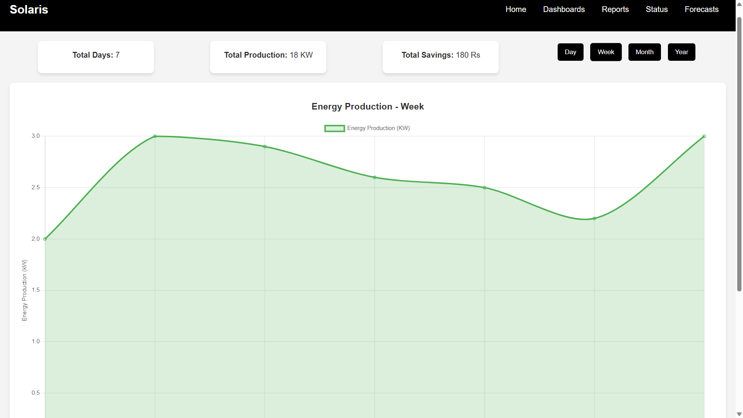
Screenshots
Weekly Report Module
CSE (DATA SCIENCE)

Slide 43
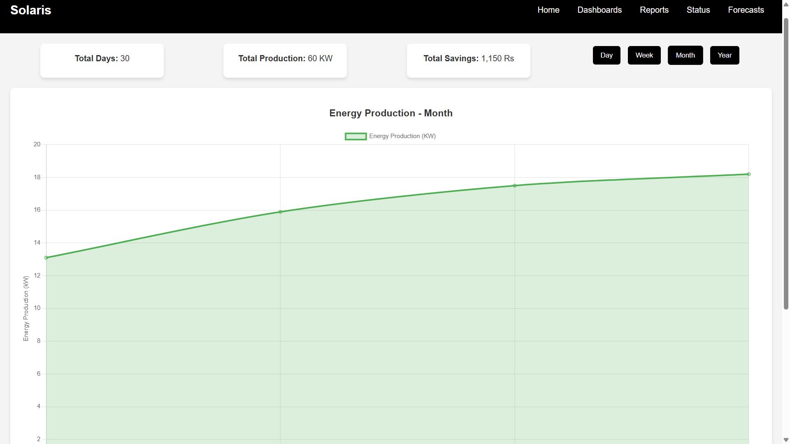
Screenshots
Monthly Report Module
CSE (DATA SCIENCE)

Slide 44
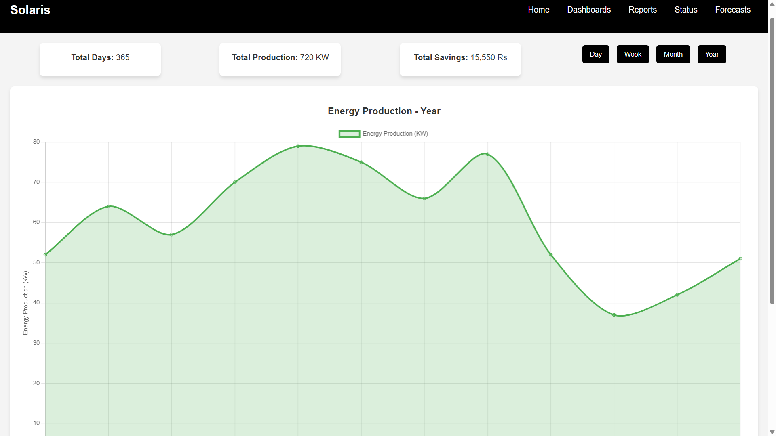
Screenshots
Yearly Report Module
CSE (DATA SCIENCE)

Slide 45
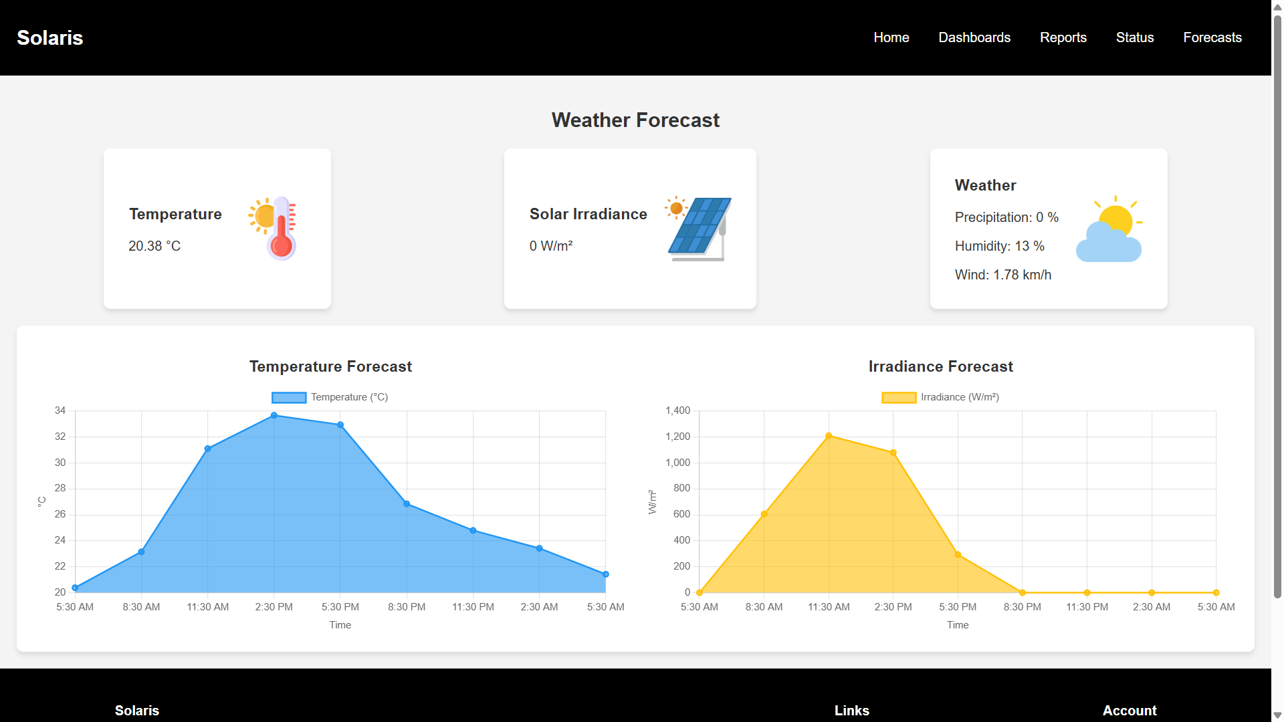
Screenshots
Forecast Module
CSE (DATA SCIENCE)

Slide 46
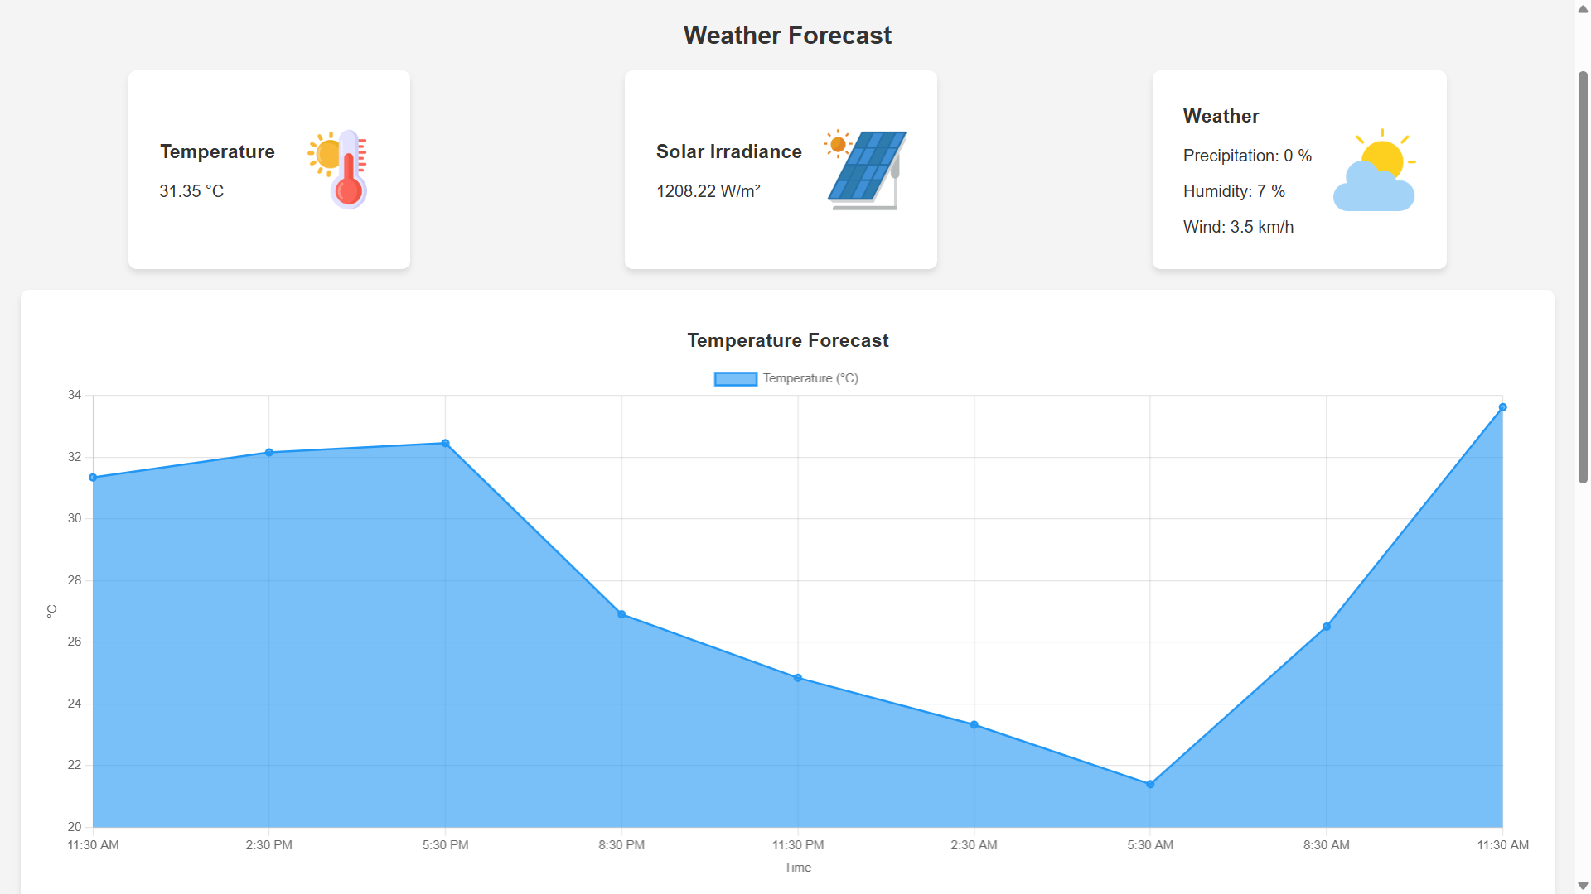
Screenshots
Forecast - Temperature Module
CSE (DATA SCIENCE)

Slide 47
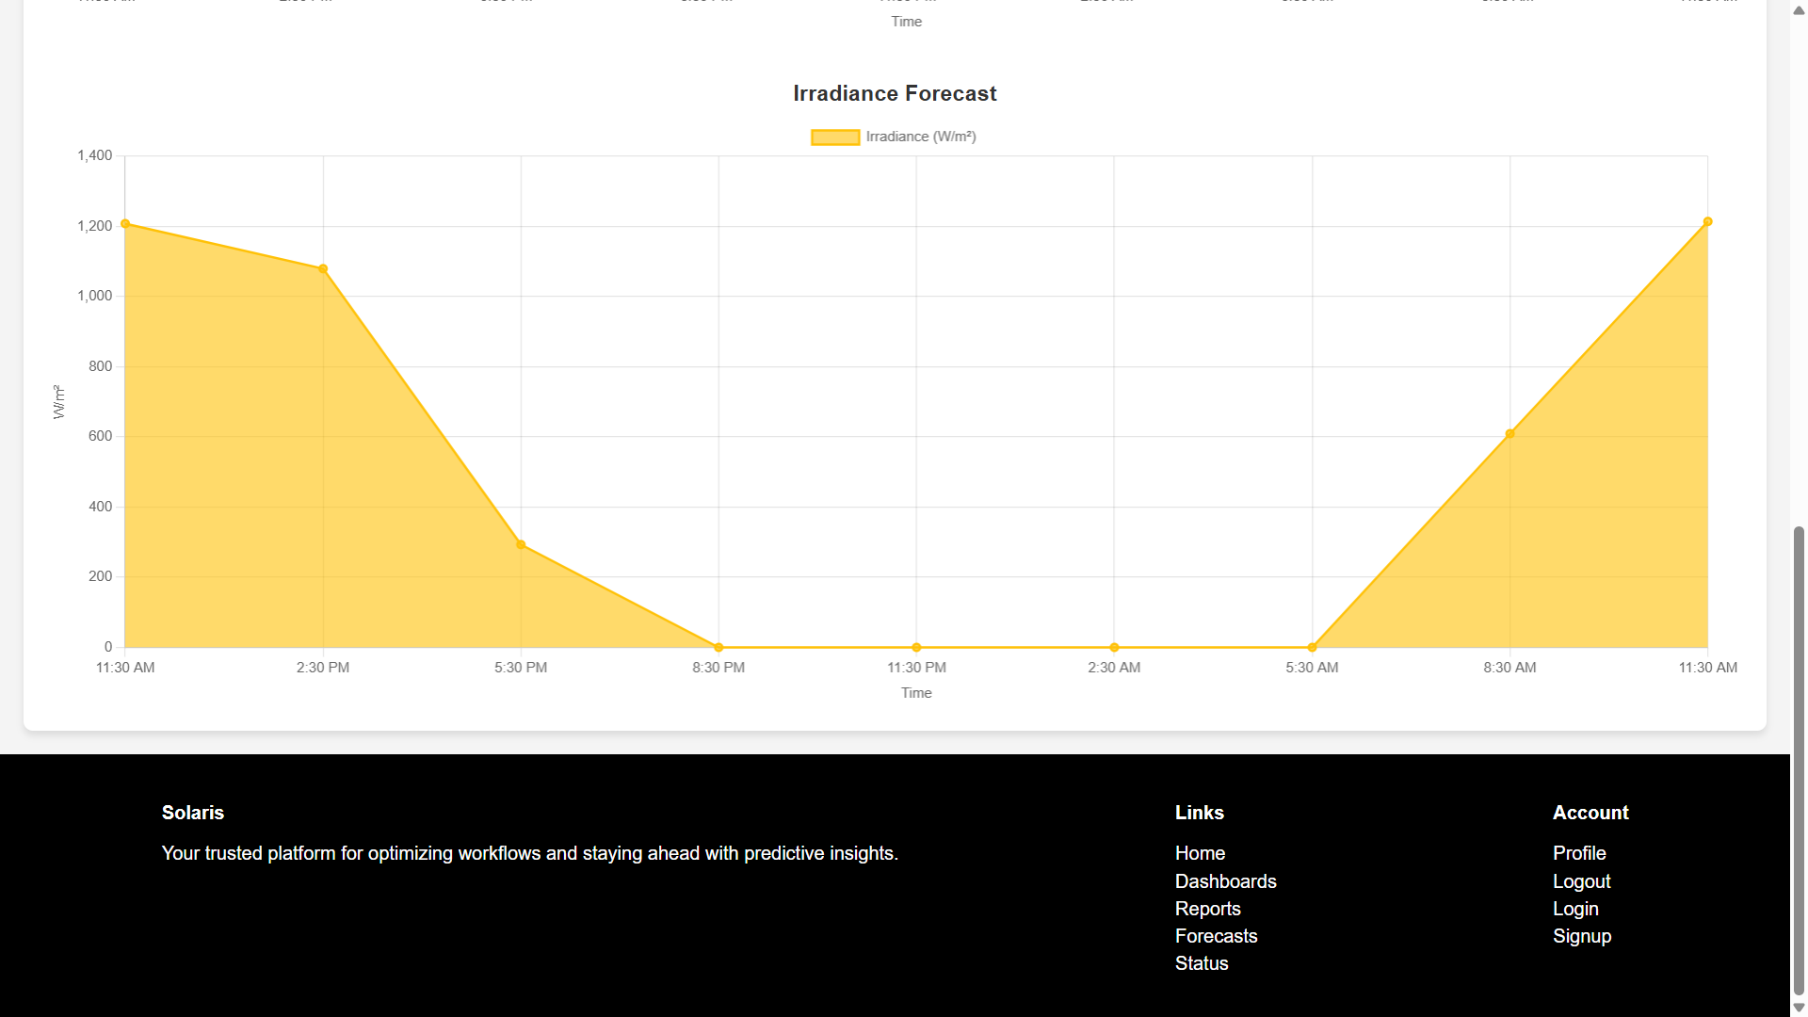
Screenshots
Forecast - Irradiance Module
CSE (DATA SCIENCE)

Slide 48
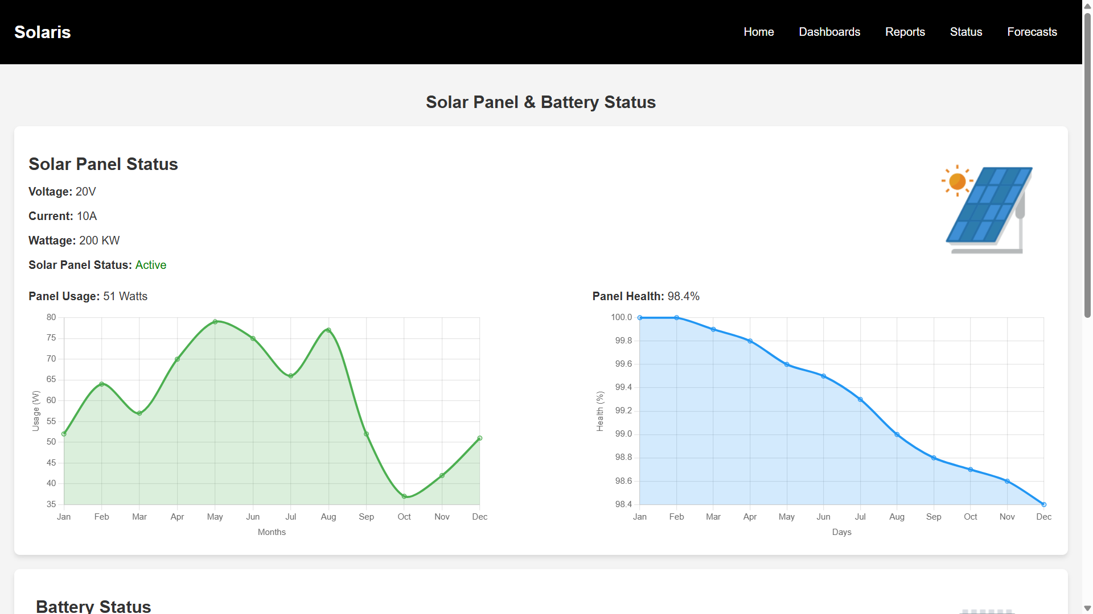
Screenshots
Solar Panel Status Module
CSE (DATA SCIENCE)

Slide 49
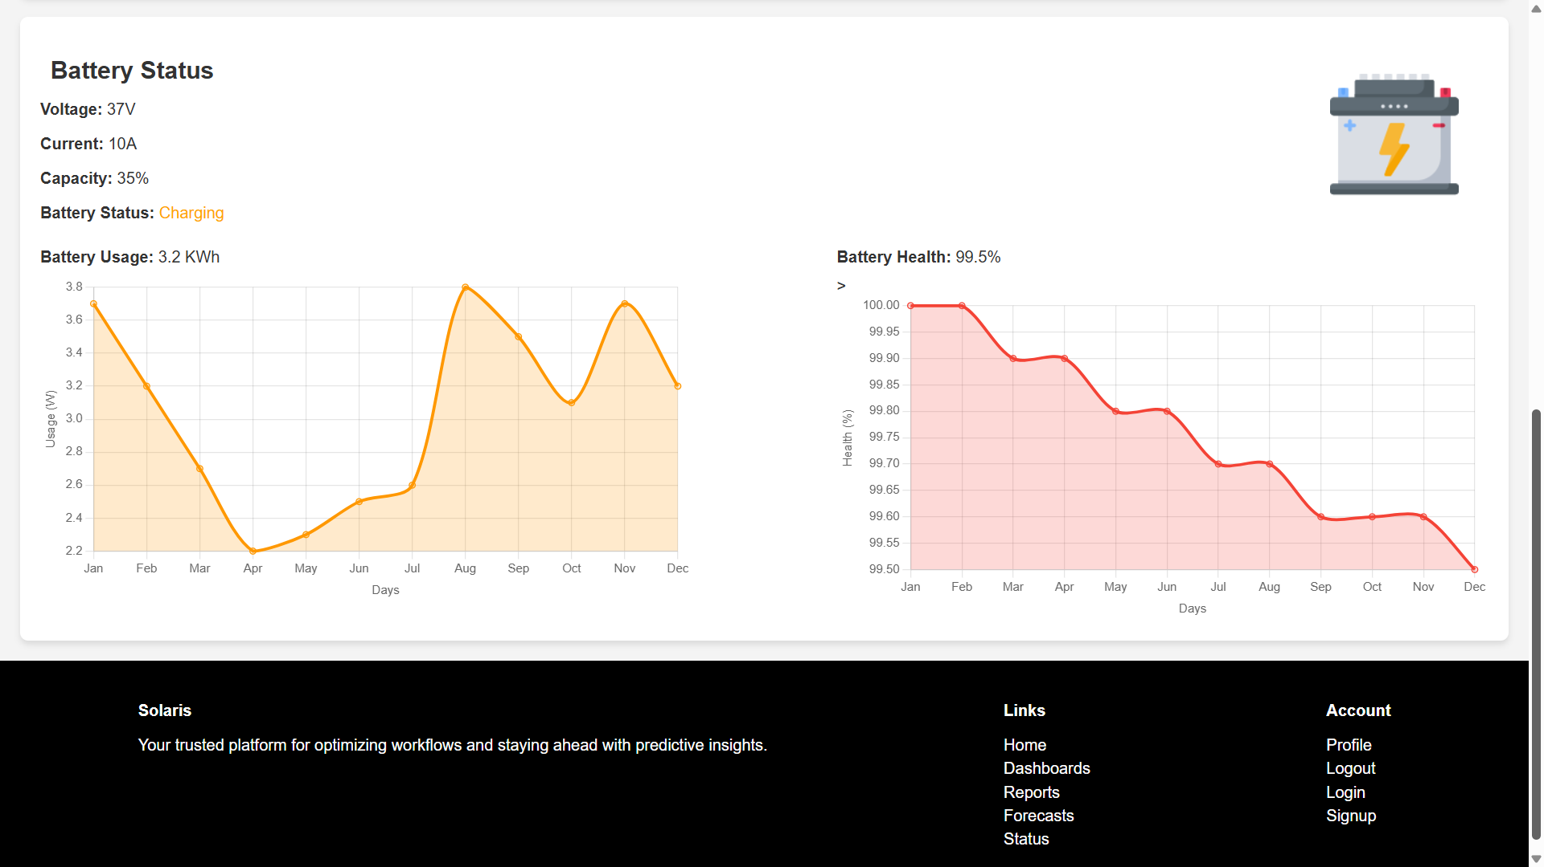
Screenshots
Battery Status Module
CSE (DATA SCIENCE)

Slide 50
Conclusion
The “Intelligent Energy Re-routing in Smart Solar Homes using ML” project represents a significant advancement in the field of sustainable energy management. By intelligently forecasting weather conditions, predicting household energy demand, and making dynamic decisions on energy utilization, the system minimizes reliance on grid power and optimizes the use of solar-generated energy. This approach not only reduces the overall carbon footprint of residential homes but also enhances energy efficiency, providing a robust solution to the growing challenges of energy sustainability in modern living environments. Looking ahead, the project holds the potential for further development and integration with broader smart home ecosystems. The adaptability of the system allows for expansion into more complex scenarios, such as integrating with other renewable energy sources or scaling up for community-based energy management. As the demand for energy-efficient solutions continues to rise, this project lays a strong foundation for creating smarter, greener homes that contribute to a more sustainable future.
CSE (DATA SCIENCE)

Slide 51
THANK YOU
CSE (DATA SCIENCE)

